Slide 1
Correlating Cardiovascular Risk Factors and Chances of Getting a Heart Attack
Team Members:
Vijay Bagavatula
Vin Dixit
Kendall Gouldthorpe
Yannick Kalukuta
Dinesh Lamba
Adil Sarwar
Date: July 30, 2019
Notes:
Dinesh

Slide 2
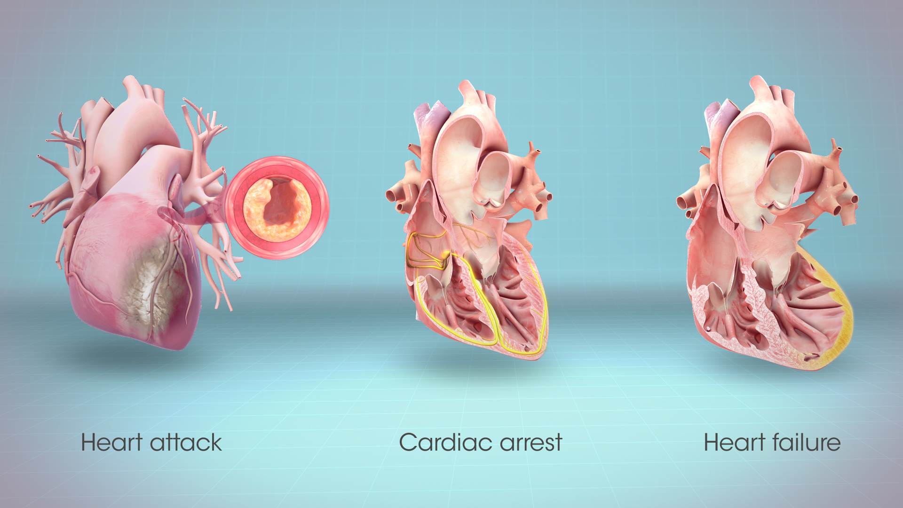
Project Objective and Idea Exploration
To make an inference on whether lifestyle choices (smoking, alcohol intake, physical activity), body vitals (age, height, weight, gender), and/or blood indices (cholesterol, glucose, systolic and diastolic blood pressures), data collected from 70,000 patients, can be used as risk factors to establish a propensity for getting a heart attack or not.
Notes:
Dinesh

Slide 3

Project Hypotheses
H0: There is no correlation between the risk factors and chances of getting a heart attack.
H1: There is a correlation between the risk factors and chances of getting a heart attack.
Notes:
Dinesh

Slide 4

Key Motivators:
Cardiovascular Disease (CVD) is the major cause of health disparities and rising healthcare costs in the United States (1 in 4 deaths;someone has a heart attack every 40 seconds according to CDC)
CVD is the leading cause of death and a major cause of disability worldwide.
Questions for Consideration:
Does alcohol intake lead to a greater risk of heart attack?
Does smoking lead to a greater risk of heart attack?
Does being physically active minimize the risk of a heart attack?
Does gender pose a risk of getting a heart attack?
https://www.cdc.gov/dhdsp/data_statistics/fact_sheets/fs_heart_disease.htm
Notes:
Dinesh

Slide 5
Methodology
The presence or absence of cardiovascular disease is our target variable. All other parameters will be independent variables for comparison.
The dataset will be then be split into two data sets, cardiovascular disease present and cardiovascular disease not present.
Using these two datasets, we will compare each against one another for every variable available using T-test for numerical data and Chi Square Test for categorical data.
The returned p-values will determine whether that particular variable is a possible correlator for heart attack or not.
Notes:
Vijay

Slide 6
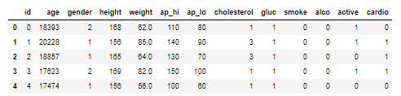
Risk Factors

Slide 7
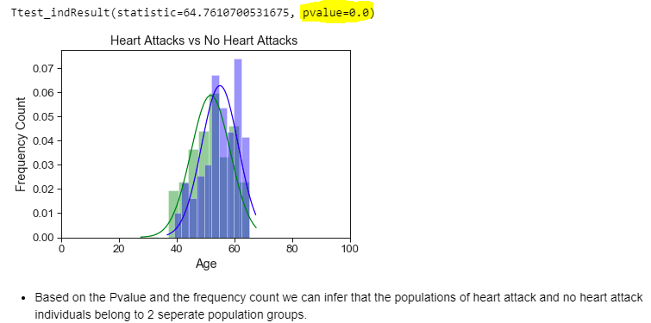
Age [Numerical]
Heart Attack
No Heart Attack
Notes:
Vijay

Slide 8
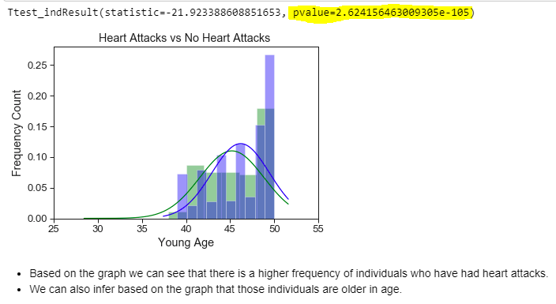
Young Age [Numerical]
Heart Attack
No Heart Attack
Notes:
Vijay

Slide 9
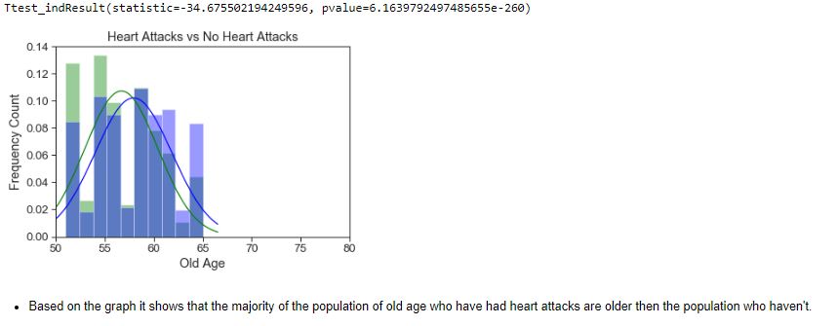
Old Age [Numerical]
Heart Attack
No Heart Attack
Notes:
Vijay

Slide 10
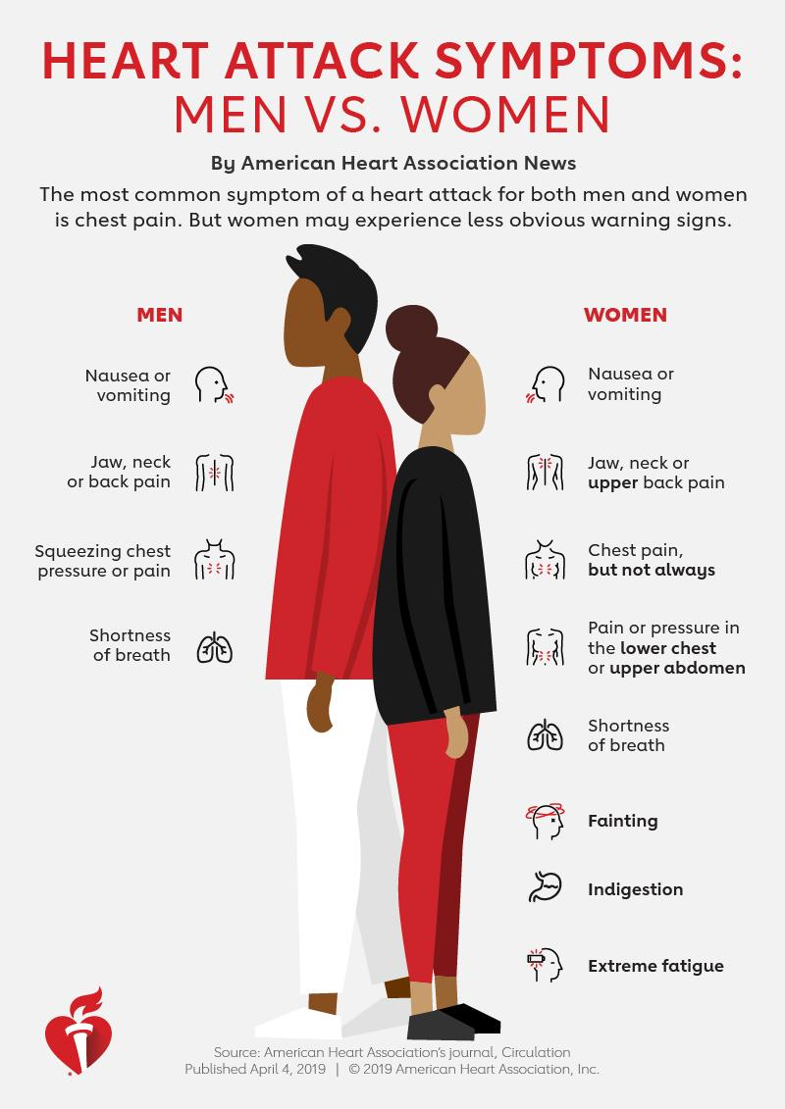
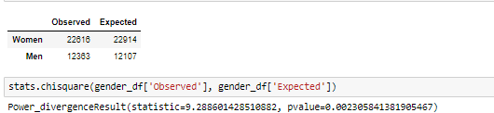
Gender [Categorical]
Null hypothesis- There is no correlation between gender and propensity of getting a heart attack
Hypothesis - There is a correlation between gender and propensity of getting a heart attack
Notes:
Vijay

Slide 11
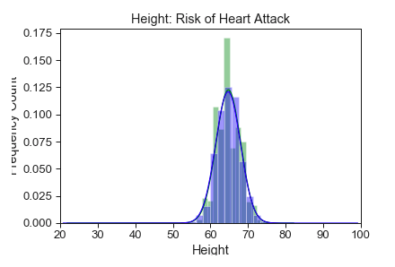
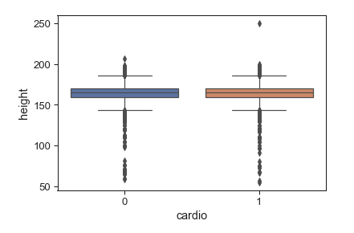
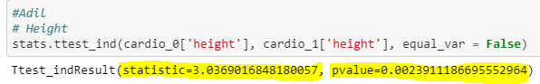
Height [Numerical]
Upon our initial T-test, we came to the conclusion that based on the trend line the data (Green - No Heart Attack, Blue - Heart Attack) was overlapping
Therefore, we ran a Box Plot to further drill down on these results and we can see that they have the same frequency, which proves height by itself is not good enough of a predictor
However, based on the T-test and its returned P-Value which is less than 0.05. We reject the Null Hypothesis (H0)
Heart Attack
No Heart Attack
Notes:
Adil

Slide 12
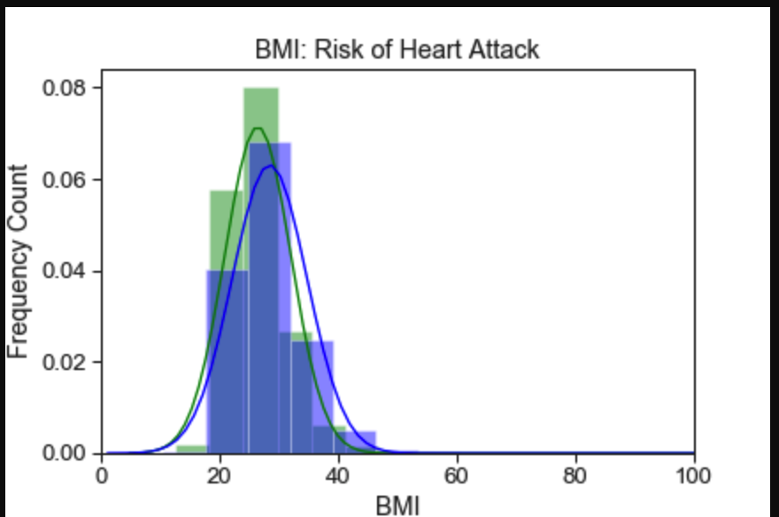
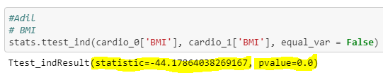
BMI [Calculated Numerical]
Since our initial risk factor “Height” did not have an accurate visual representation of the data we decided to use “Body Mass Index (BMI)” as an alternative risk factor.
Upon performing a T-test on BMI we can clearly see a distinction between the people who had no heart attack (green) and people who had a heart attack (blue)
Based on the T-test and its returned P-Value which is less than 0.05. We still reject the Null Hypothesis (H0)
Heart Attack
No Heart Attack
Notes:
Adil

Slide 13
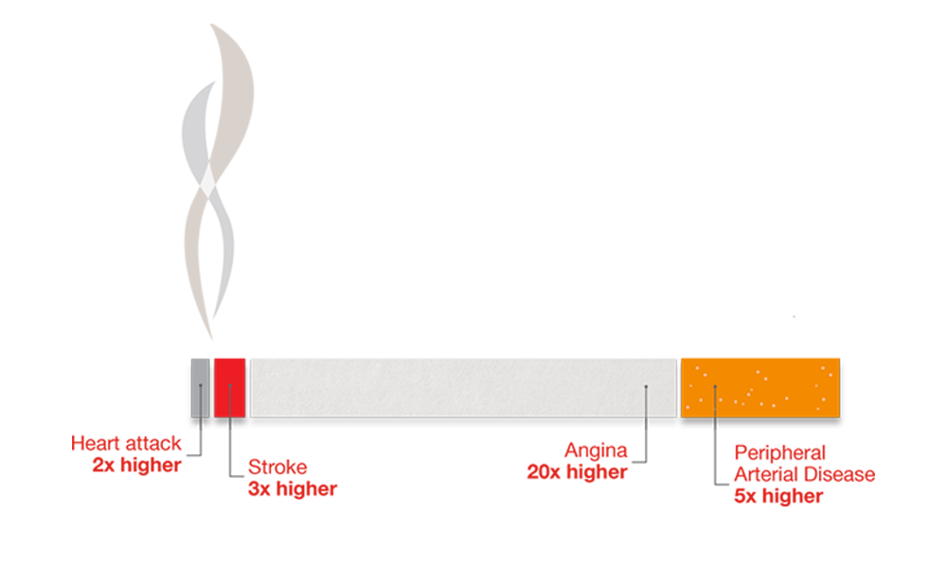
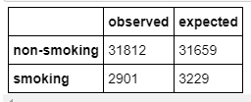
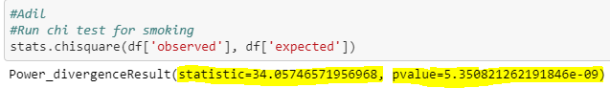
Smoking [Categorical]
Despite smoking leading as one of the most preventable causes of heart disease, we decided to run a Chi-Square test on a population of smokers vs non-smokers
H0(Null): There is no correlation between smoking and the propensity of getting a heart attack
H1: There is a correlation between smoking and the propensity of getting a heart attack
Chi-Square Test: We can reject the Null Hypothesis (H0) since our P-Value < 0.05
Data:
Observed (Heart Attack)
Expected (No Heart Attack)
Notes:
Adil

Slide 14
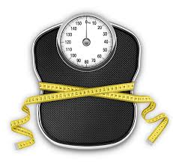
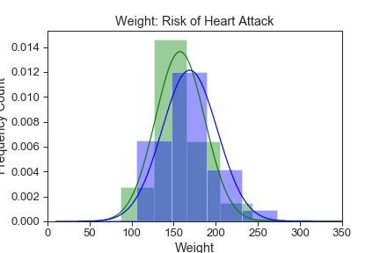
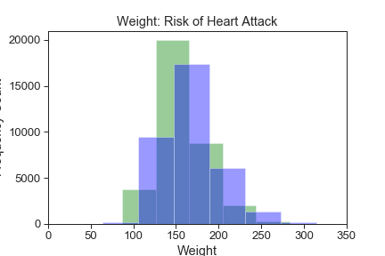
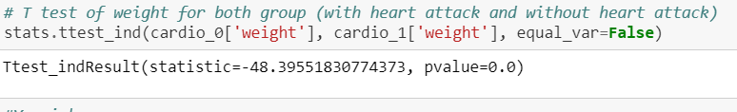
Weight [Numerical]
One can assume that higher weight and obesity can lead to heart disease, after all the Center of Disease Control list Overweight and obesity as risk factors. Weight is not a predictor for heart disease.
The graph shows no heart attack (green) in lower weight compared to heart a attack (blue). (no heart attack count: 35021; heart attack count: 34979) majority age :40-65 ‘Ish
T test of weight for both group (with heart attack and without heart attack) : statistic= -48.395pvalue= p-value = 0.0
P-value = 0 (p-value< 0.05. the null hypothesis can be rejected)
*https://www.cdc.gov/dhdsp/data_statistics/fact_sheets/fs_heart_disease.htm
Heart Attack
No Heart Attack
Notes:
Yannick

Slide 15

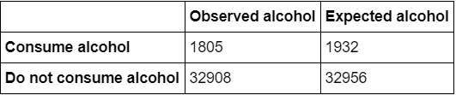
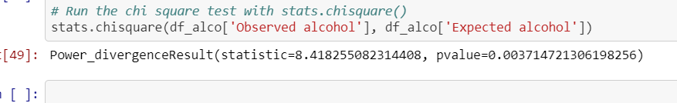
Alcohol [Categorical]
The CDC is also listing “Excessive alcohol use” as a risk factor for heart disease. Like a weight, alcohol is not a predictor for heart attack
Data :Expected (without heart attack) and Observed (with heart attack)
the chi square test with stats : statistic=8.418255082314408, pvalue=0.003714721306198256
We can reject the null hypothesis since the P-value < 0.05 (however not statistically significant)
*https://www.cdc.gov/dhdsp/data_statistics/fact_sheets/fs_heart_disease.htm
Notes:
Yannick

Slide 16
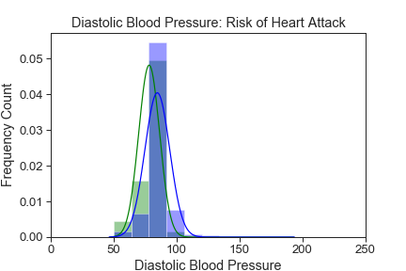
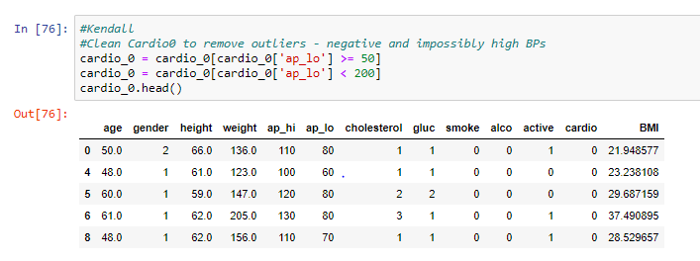
Diastolic Blood Pressure (DBP) [Numerical]
We cleaned up the data to remove negative and impossibly high blood pressures from both the heart attack and no heart attack group.
After running the cleaned DBP through the t-test in Scipy. The returned p-value was equal to 0.0.We can reject the null hypothesis.
Heart Attack
No Heart Attack
Notes:
Kendall

Slide 17
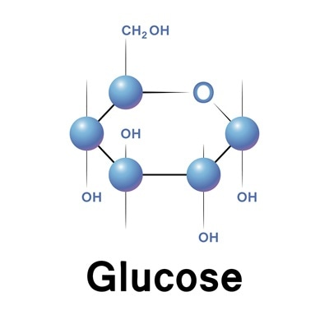
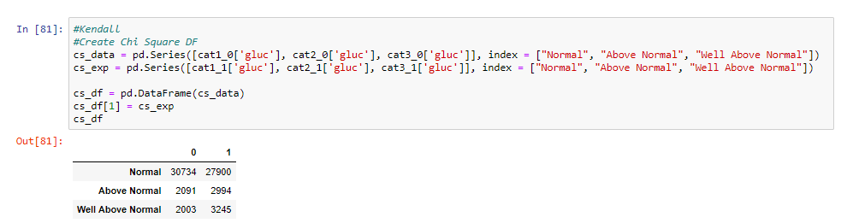
Glucose [Categorical]
Glucose was broken down into 3 categories:
Normal
Above Normal
Well Above Normal
Using Chi Square Test:
The returned p-value was 1.3362911220535194e-225. Meaning we can reject the null hypothesis and state that glucose is a likely correlator to heart attack.
Notes:
Kendall

Slide 18
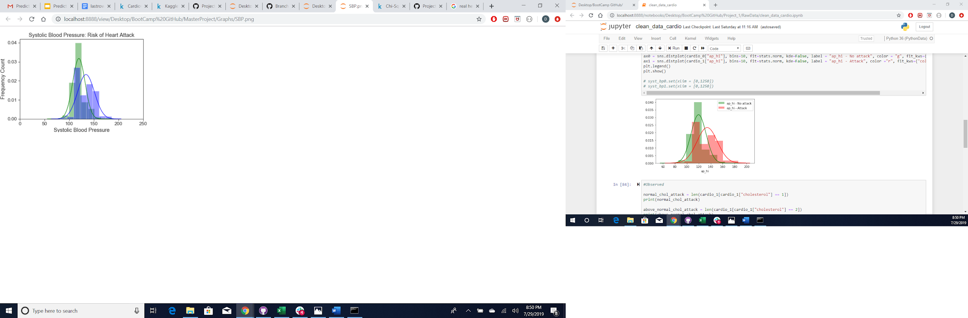
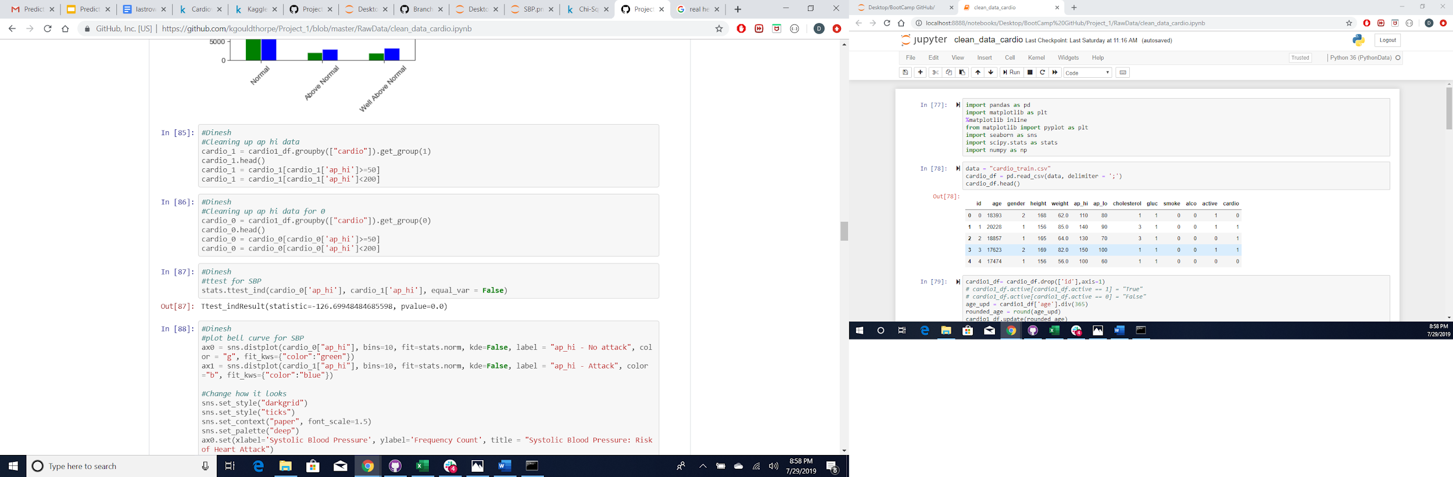
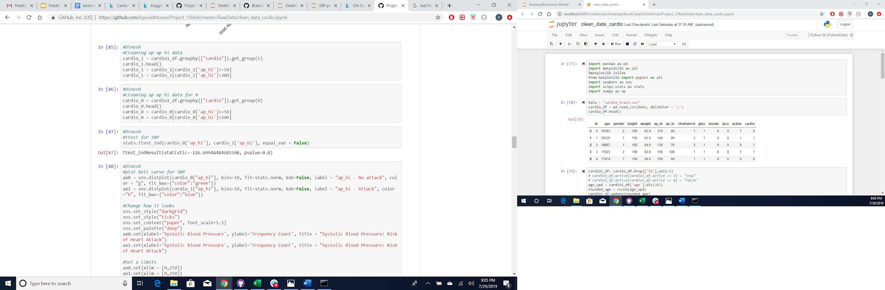
Systolic Blood Pressure (SBP) [Numerical]
Heart Attack
No Heart Attack
Data was scrubbed to remove anomalies of negative and extremely low and high readings of SBP from the heart attack and no heart attack groups.
The p-value, after running the t-test on the scrubbed SBP data, resulted in 0.0. Hence, we can assume that higher the SBP, greater the propensity of getting a heart attack.
Notes:
Dinesh

Slide 19
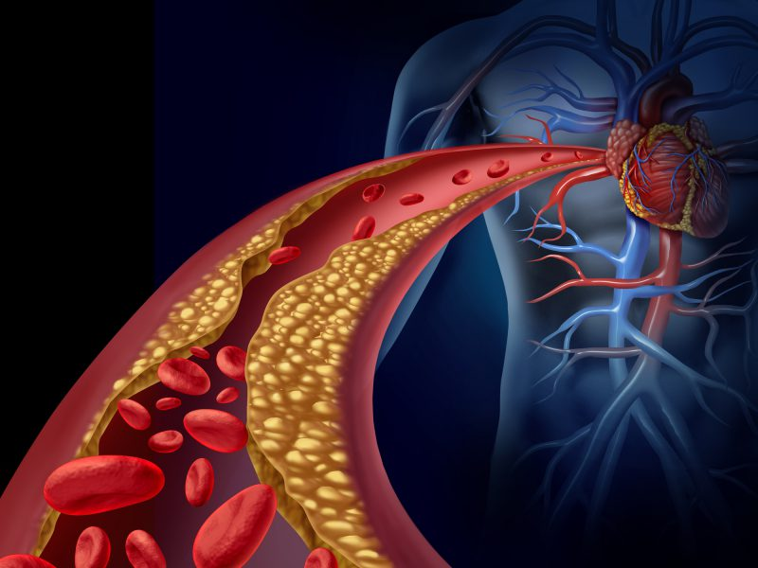
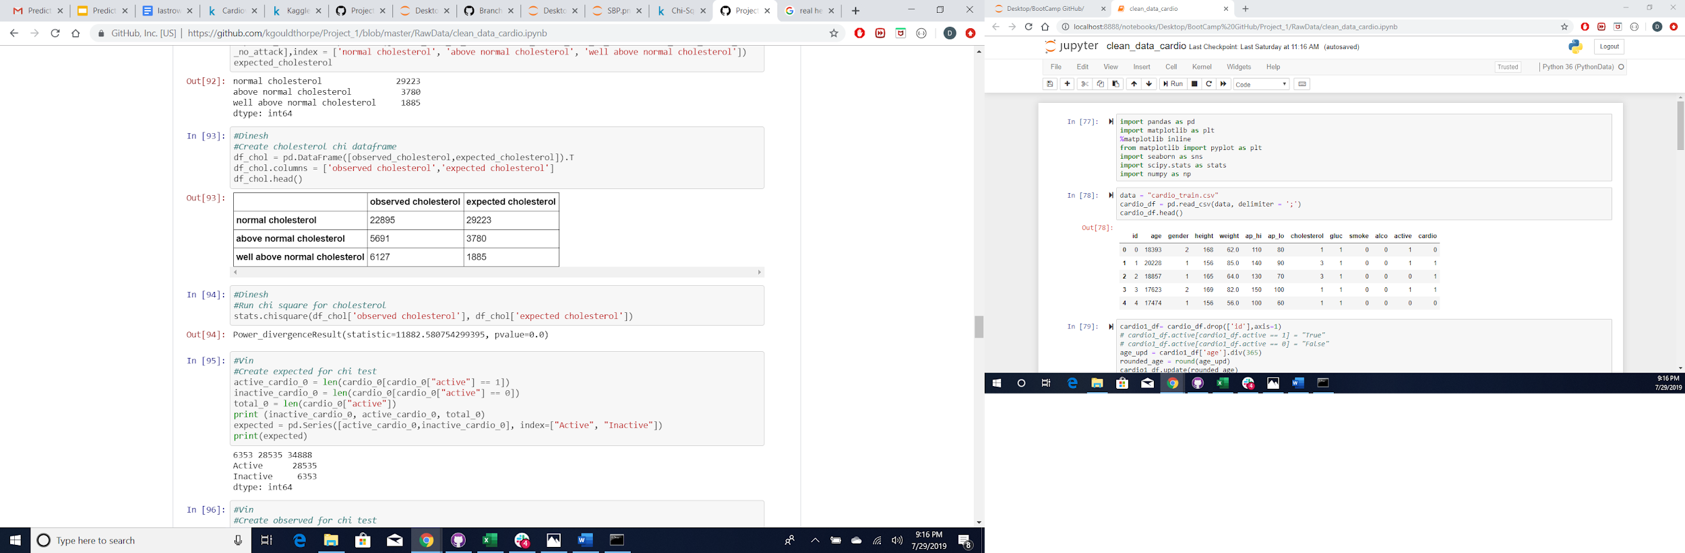

Cholesterol [Categorical]
The data set for Cholesterol was subdivided into 3 categories:
Normal
Above Normal
Well Above Normal
H0: There is no correlation between cholesterol and propensity of getting a heart attack
H1: There is a correlation between cholesterol and propensity of getting a heart attack
There is a significant relationship between cholesterol and propensity of heart attack between two groups namely heart attack (observed) & no heart attack (expected) based on results from the Chi-square test where the p-value = 0.0.
Notes:
Dinesh

Slide 20
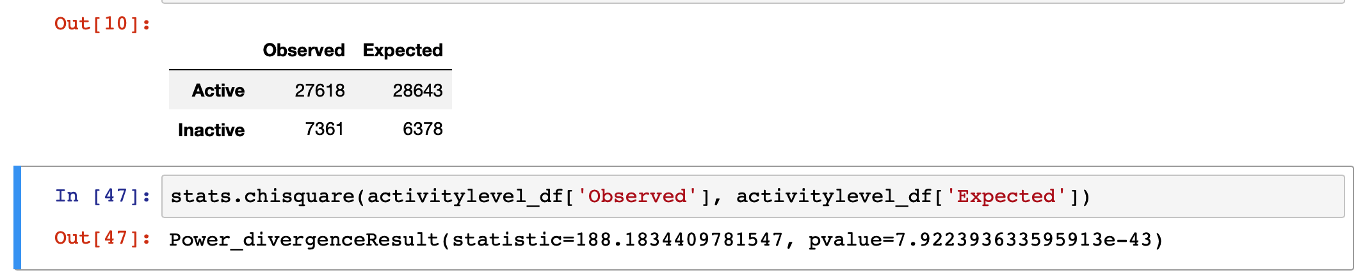
Physical Activity [Categorical]
It is intuitive to think people who are physically active would have a lower propensity for getting a heart attack.
H0 : Physical activity in humans is not a predictor for getting a heart attack
H1 : Physical activity in humans is a predictor for getting a heart attack
Chi-square test results: Reject the Null Hypothesis (H0) based on P-value < 0.05
Notes:
Vin

Slide 21
Summary
Statistically, it can be concluded that lifestyle choices (smoking, alcohol intake, physical activity), body vitals (age, height, weight, gender), and/or blood indices (cholesterol, glucose, systolic and diastolic blood pressures), can be used as risk predictors for getting a heart attack or not.
Height of a person cannot be utilized alone as predictor but when combined with weight through BMI, the body vital category can be used effectively.
The real use of this information is in building a predictive model using logistic regression as the next step
Notes:
Vin

Slide 22

Lessons Learned
Keep the problem statement precise and manageable
Focus on cleaning the data before diving in into analysis
Learn code integration techniques
Pseudocode and develop projects steps in planning stages thoroughly
Understand statistical concepts before running analysis
Notes:
Vin

